Slide 1
p-Causality: Identifying the spatiotemporal causal pathway for air pollutants with urban big data

Slide 2
Outline
Motivation & challenges
Framework
Pattern mining module
Bayesian learning module
Verification
Conclusion

Slide 3
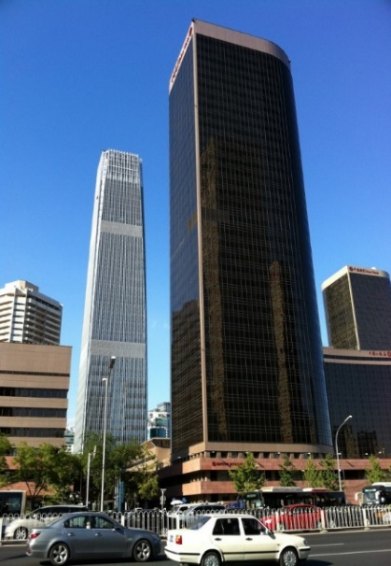
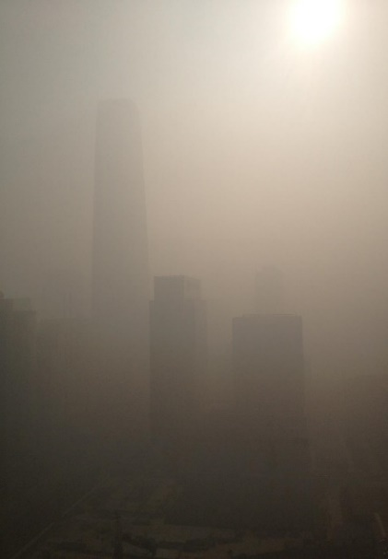
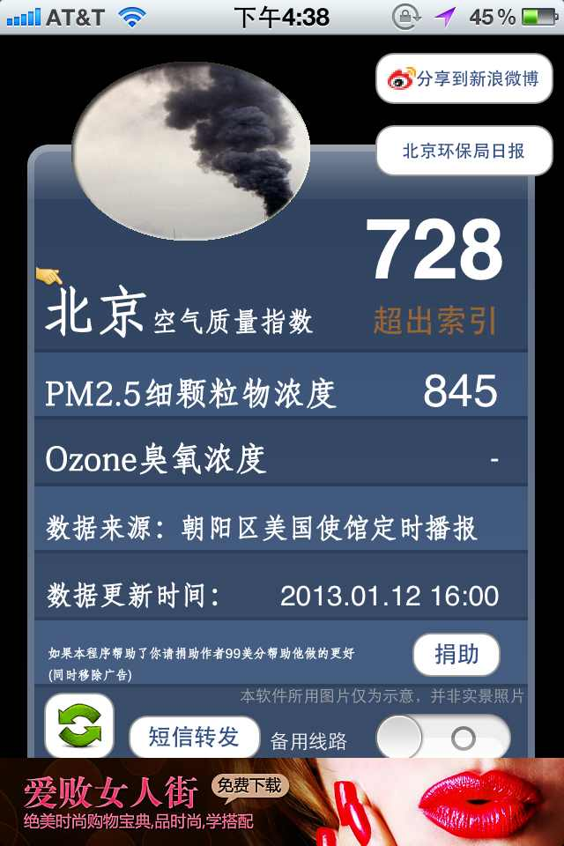
Background - Air pollution has become a major problem in China
China World Trade Center Tower III, Beijing
China World Trade Center Tower III, a 1,000 plus foot skyscraper that’s one of the tallest in Beijing. Jan 12th,2013. Photo courtesy of Bill Bishop/Sinocism China Newsletter

Slide 4
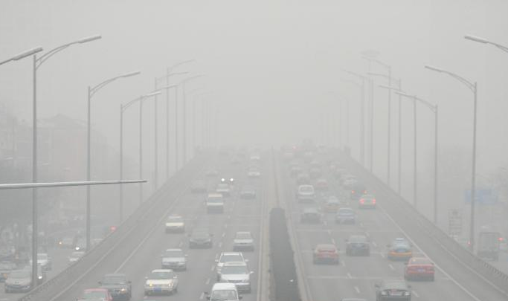
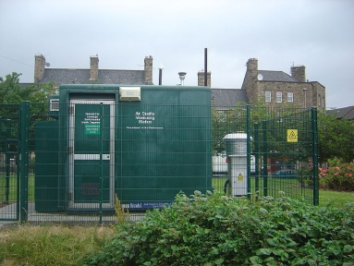
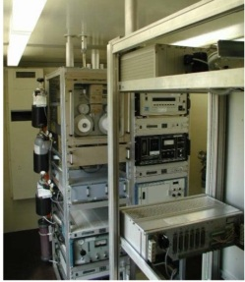
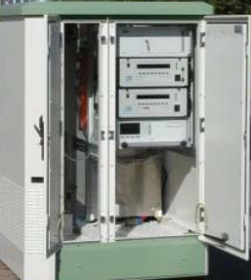
Cities have built on-the-ground monitoring stations to inform the pollution concentration
Air quality monitor station
Estimating and forecasting fine-grained air quality with urban big data (KDD’13 &14&15; INFOCOM Smart Cities 15&16 )
However, the questions is: I know the air quality is bad. I am living in Beijing. What can I do?

Slide 5
Motivation: Cause-and-effect analysis
Identify the causality for air pollutants in the spatiotemporal space.
To inform the public policy making
Where do the pollutants come from?
How much do they cause each other?
In the meanwhile, we find the time series of pollutants show similar trends even 300km far away!

Slide 6
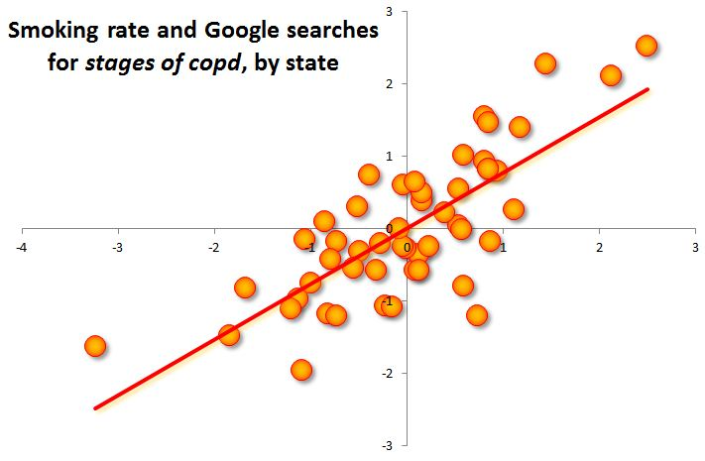
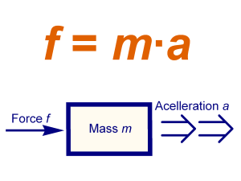

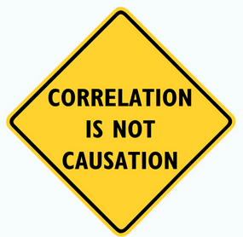
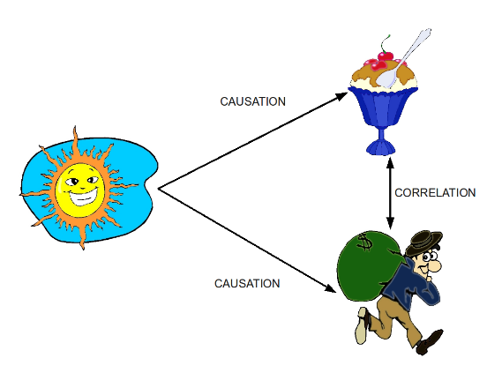
Definition of causality
Physics, mathematics, statistics…
Force => Acceleration
If X => then Y
If not X => then not Y
Statistical cause-and –effect relations
Image from Wikipedia.org
Notes:
LAST FIGURE is from wikipedia

Slide 7
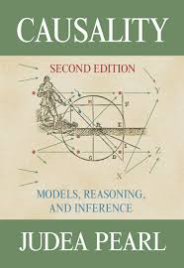

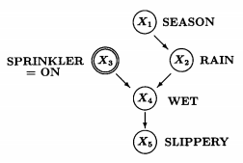
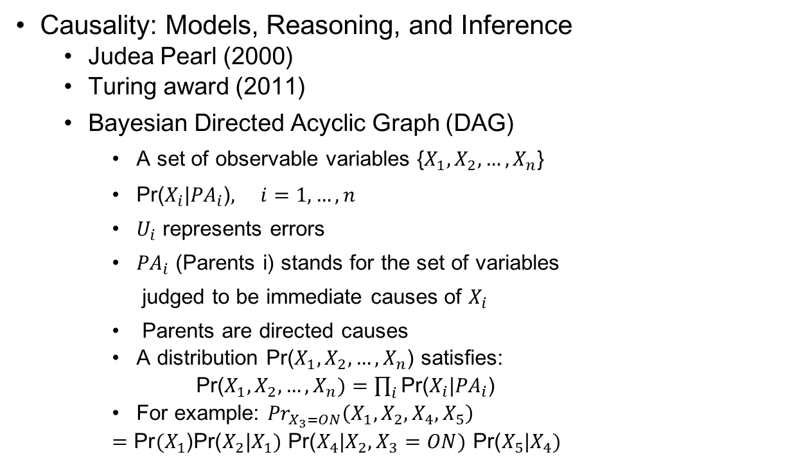
How to identify the causality driven by data?
Causality: Models, Reasoning, and Inference
Judea Pearl (2000)
Turing award (2011)
Bayesian Directed Acyclic Graph (DAG)
A set of observable variables {$X_{1},X_{2},…,X_{n}$}
$\text{Pr}\text{(}X_{i}\text{|}{PA}_{i}\text{)}, i=1,…,n$
$U_{i}$ represents errors
${PA}_{i}$ (Parents i) stands for the set of variables
judged to be immediate causes of $X_{i}$
Parents are directed causes
A distribution Pr($X_{1},X_{2},…,X_{n}$) satisfies:
Pr($X_{1},X_{2},…,X_{n})=\prod_{i}{\text{Pr}\text{(}X_{i}\text{|}{PA}_{i}\text{)}}$
For example: ${Pr}_{X_{3}=ON}\left(X_{1},X_{2},X_{4},X_{5}\right)$
$=\text{Pr}(X_{1}\text{)}\text{Pr}\text{(}X_{2}\text{|}X_{1})$ $\text{Pr}\text{(}X_{4}\text{|}X_{2},X_{3}=ON)$ $\text{Pr}\text{(}X_{5}\text{|}X_{4})$
Markov
Bayesian learning: 1) Given variables {$X_{1},X_{2},…,X_{n}$} and their distributions, recover DAG structure. 2) Given the DAG structure, identify the effect exposed to the cause.

Slide 8
Limitation of traditional causality models
Two key aspects for traditional causality models
1. Probabilistic inference over pre-assumed causal structures
2. Human intervention on the experiments (e.g. sprinkler is on/off)
However, for air quality, traditional causality models have limitations:
1. The causal structure for air pollution in the geo-space is complex, not easy to be pre-assumed, and
2. We can not conduce pollution-related human intervention in such a large area.
Therefore, we consider data-driven causality learning approach, to identify the causal pathways from urban monitoring records.

Slide 9
Challenges
Our goal: learn a graphical causal structure that encodes the causal relationships among different air pollutants in the ST space , from a database of urban monitoring records
Not all air pollution data are useful for causality analysis.
Large amounts of time series data in the ST space.
Air pollution causal pathways are complex in nature.
Notes:
First, not all air pollution data are useful for causality analysis.
Uninteresting fluctuations and noisy variations
Second, large amounts of data
Hundreds of monitoring stations
Discovering causal relationships from millions of records is challenging.
Third, air pollution causal pathways are complex in nature.
The air polluting process typically involves multiple types of pollutants that are mutually interacting, and is subject to local reactions, ST propagations and confounding factors, such as wind and humidity.

Slide 10
Challenge 1: Not all air pollution data are useful for causality analysis
We care about increasing and decreasing trends/patterns

Slide 11
Challenge 2: Large amounts of time series data in the ST space
6 pollutants, 5 weather factors
PM2.5, PM10, NO2, CO, O3, SO2
temperature (T), pressure (P), humidity (U), wind speed (WS), and, wind direction (WD)
128 cities, 982 air pollution monitoring stations , 3 metropolitan regions of China.
North China, Yangtze River Delta (YRD), Pearl River Delta (PRD)
4 seasons
Jan-Mar (Spring), Aril-Jun (Summer), Jul-Sep (Autumn), Oct-Dec (Winter)
Around 3.5 years’ data
06/01/2013 - 12/31/2016

Slide 12
Challenge 3: Air pollution causal pathways are complex in nature
Geo-space, multiple pollutants, different weather conditions.

Slide 13
We propose p-Causality: a pattern- aided causality analysis approach.
Combining the strengths of pattern mining and statistical modeling.

Slide 14
Framework:
Combine pattern mining with Bayesian learning

Slide 15
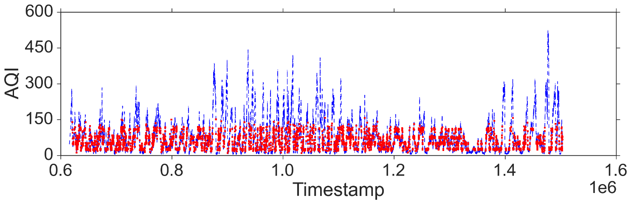
Pattern mining module - Frequent evolving patterns (FEPs) as events
The frequent evolving patterns could:
Eliminate many small fluctuations and long-term whole-area low pollution periods.
Capture the frequently occurring changes, to be considered as “events” in a causal system.
Take the PM2.5 in North China as an example:
26 continuous evolving patterns in total
#Total records: 17308# pattern matching records: 6598

Slide 16
Pattern mining module - Frequent evolving patterns (FEPs) as events
Methodology: find the frequent evolving patterns (FEP) for each air pollutant to understand its evolving behavior.
Classic definition of FEP : a subsequence that matches at least n sequences (n is the support threshold).
Sequence Database:
C->A->B->B
A->C->B->A
B->A->B
B->B->C
For continuous evolving pattern, an extension of the sequential pattern that requires:
The items should be consecutive in the sequence
Any consecutive items should be different
Sequential Pattern (n=3):
A->B
B->B
Continuous evolving pattern (n=3):
A->B
Continuous evolving patterns can be mined by extending the PrefixSpan algorithm. Question: the raw pollutants data are continuous values, how to convert the time series into a symbolic sequence?

Slide 17
Pattern mining module - Frequent evolving patterns (FEPs) as events
Convert the time series of each pollutant into a symbolic sequence based on Symbolic Aggregate approXimation (SAX)
Symbolic Aggregate approXimation (SAX) is designed for representing a continuous time series as a symbolic sequence.
Key idea: the value of the condition follows a Gaussian distribution, given a vocabulary size N, it chops the interval into N qui-probability bins.
An example of SAX: (ECDECDDCBBCCBCEEBEDB)
Air pollutants time series (e.g. PM2.5 in North China, long tail distribution)
F E D C B A

Slide 18
Pattern mining module - ST candidate cities selection
Complexity reduction. E.g. Beijing PM2.5, different geographical distributions for candidate cities
Four seasons: target city (star), candidate cities (circle).
Notes:
Select candidate cities if the similarity of FEPs given a threshold.
Candidate cities show different geographical distributions according to four cities

Slide 19
Framework:
Combine pattern mining with Bayesian learning

Slide 20
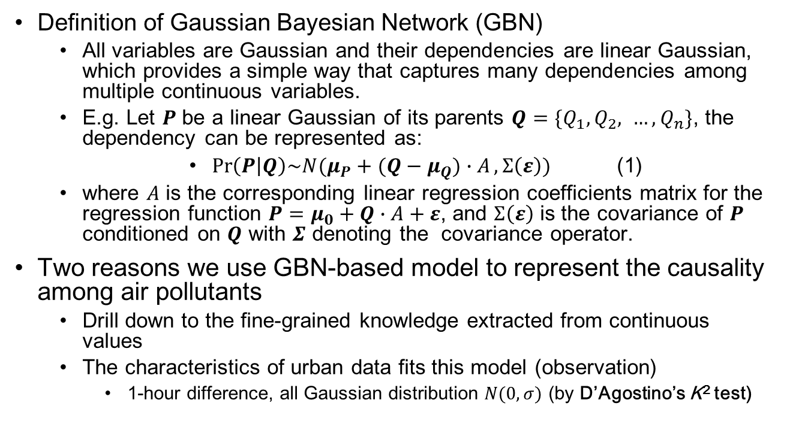
Causal pathway representation module – GBN-based causality model
Definition of Gaussian Bayesian Network (GBN)
All variables are Gaussian and their dependencies are linear Gaussian, which provides a simple way that captures many dependencies among multiple continuous variables.
E.g. Let $P$ be a linear Gaussian of its parents $Q=\{Q_{1}, Q_{2}, …, Q_{n}\}$, the dependency can be represented as:
$\operatorname{Pr}\left(P | Q\right)\sim N(μ_{P}+(Q−μ_{Q})∙A,Σ\left(ε\right))$ (1)
where $A$ is the corresponding linear regression coefficients matrix for the regression function $P=μ_{0}+Q∙A+ε$, and $Σ\left(ε\right)$ is the covariance of $P$ conditioned on $Q$ with $Σ$ denoting the covar­ian­ce operator.
Two reasons we use GBN-based model to represent the causality among air pollutants
Drill down to the fine-grained knowledge extracted from continuous values
The characteristics of urban data fits this model (observation)
1-hour difference, all Gaussian distribution $N(0,σ)$ (by D’Agostino’s K² test)

Slide 21
Causal pathway representation module – GBN-based causality model

Slide 22
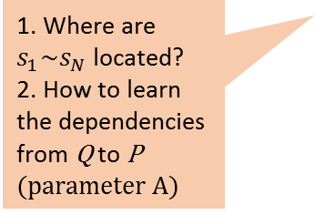
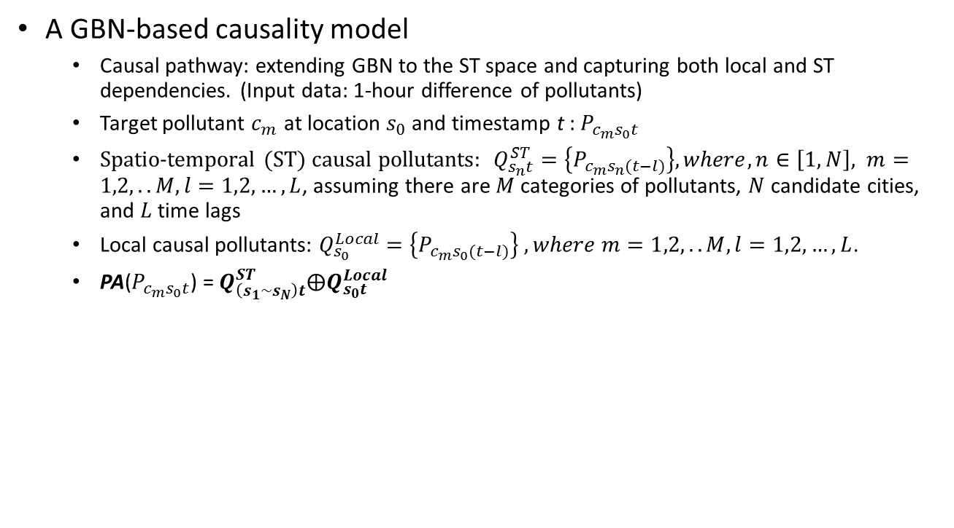
Causal pathway representation module – GBN-based causality model
A GBN-based causality model
Causal pathway: extending GBN to the ST space and capturing both local and ST dependencies. (Input data: 1-hour difference of pollutants)
Target pollutant $c_{m}$ at location $s_{0}$ and timestamp t : $P_{c_{m}s_{0}t}$
Spatio-temporal (ST) causal pollutants: $Q_{s_{n}t}^{ST}=\left\{P_{c_{m}s_{n}(t−l)}\right\}, where, n∈\left[1,N\right], m=1,2,..M, l=1,2,…,L$, assuming there are $M$ categories of pollutants, $N$ candidate cities, and $L$ time lags
Local causal pollutants: $Q_{s_{0}}^{Local}=\left\{P_{c_{m}s_{0}(t−l)}\right\}$ $, where m=1,2,..M, l=1,2,…,L$.
PA($P_{c_{m}s_{0}t}$) = $Q_{\left(s_{1}\sim s_{N}\right)t}^{ST}⨁Q_{s_{0}t}^{Local}$
Vector
Vector
1. Where are $s_{1}\sim s_{N}$ located?
2. How to learn the dependencies from Q to P (parameter A)
$\operatorname{Pr}\left(P_{c_{m}s_{0}t} | PA(p_{c_{m}s_{0}t})\right)\sim N(μ_{P_{c_{m}s_{0}t}}+(PA(p_{c_{m}s_{0}t})−μ_{PA(p_{c_{m}s_{0}t})})∙A,Σ\left(ε_{{c_{m}s}_{0}t}\right))$ (2)

Slide 23
Bayesian learning module - Learning the causal pathway
To minimize the impact of confounding and guarantee the faithfulness of the causal structure
Step 3. Generating initial causal pathway
Step 4. Coupling confounders
Step 5. Refining causal structures

Slide 24
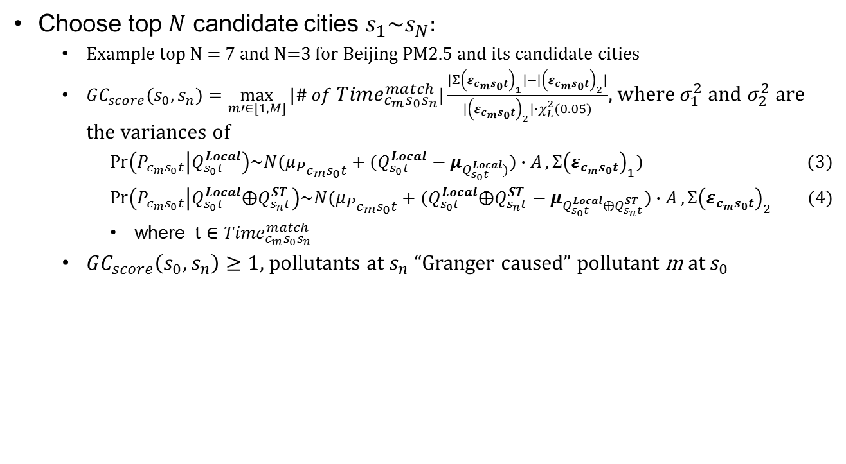
Generating initial causal pathway (top N)
Choose top $N$ candidate cities $s_{1}\sim s_{N}:$
Example top N = 7 and N=3 for Beijing PM2.5 and its candidate cities
$GC_{score}(s_{0},s_{n})=\max_{m′∈[1,M]}{|\# of {Time}_{c_{m}s_{0}s_{n}}^{match}|\frac{|Σ{\left(ε_{{c_{m}s}_{0}t}\right)}_{1}|−|{\left(ε_{{c_{m}s}_{0}t}\right)}_{2}|}{|{\left(ε_{{c_{m}s}_{0}t}\right)}_{2}|∙χ_{L}^{2}(0.05)}}$, where $σ_{1}^{2}$ and $σ_{2}^{2}$ are the variances of
$\operatorname{Pr}\left(P_{c_{m}s_{0}t} | Q_{s_{0}t}^{Local}\right)\sim N(μ_{P_{c_{m}s_{0}t}}+(Q_{s_{0}t}^{Local}−μ_{Q_{s_{0}t}^{Local})})∙A,Σ{\left(ε_{{c_{m}s}_{0}t}\right)}_{1})$ (3)
$\operatorname{Pr}\left(P_{c_{m}s_{0}t} | Q_{s_{0}t}^{Local}⨁Q_{s_{n}t}^{ST}\right)\sim N(μ_{P_{c_{m}s_{0}t}}+(Q_{s_{0}t}^{Local}⨁Q_{s_{n}t}^{ST}−μ_{Q_{s_{0}t}^{Local}⨁Q_{s_{n}t}^{ST}})∙A,Σ{\left(ε_{{c_{m}s}_{0}t}\right)}_{2}$ (4)
where $t∈{Time}_{c_{m}s_{0}s_{n}}^{match}$
$GC_{score}\left(s_{0},s_{n}\right)≥1$, pollutants at $s_{n}$ “Granger caused” pollutant m at $s_{0}$

Slide 25
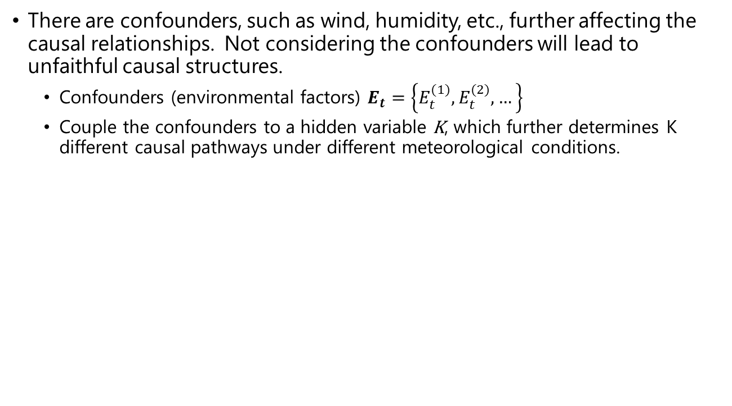
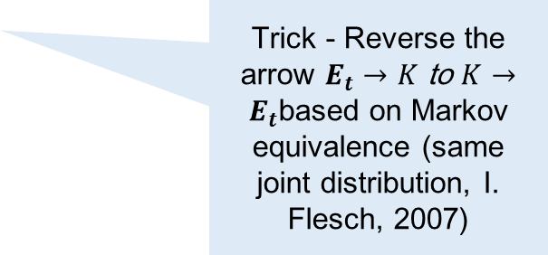
Coupling confounders
There are confounders, such as wind, humidity, etc., further affecting the causal relationships. Not considering the confounders will lead to unfaithful causal structures.
Confounders (environmental factors) $E_{t}=\left\{E_{t}^{(1)},E_{t}^{(2)},…\right\}$
Couple the confounders to a hidden variable K, which further determines K different causal pathways under different meteorological conditions.
Trick - Reverse the arrow $E_{t}→K$ to $K→E_{t}$based on Markov equivalence (same joint distribution, I. Flesch, 2007)
K can be treated as clusters in the Gaussian mixture model
Notes:
CLL: conditional log likelihood

Slide 26
Coupling confounders
Question: how many clusters?
5 clusters best represent the meteorological data (T,P,U,WS,WD time series data, dividing each regions into 9 grids, thus 45-dimensional), with their 2-D PCA projections illustrated below, in three regions of China, i.e. NC,YRD, and PRD).
Cluster K: 3~7 for experiments

Slide 27
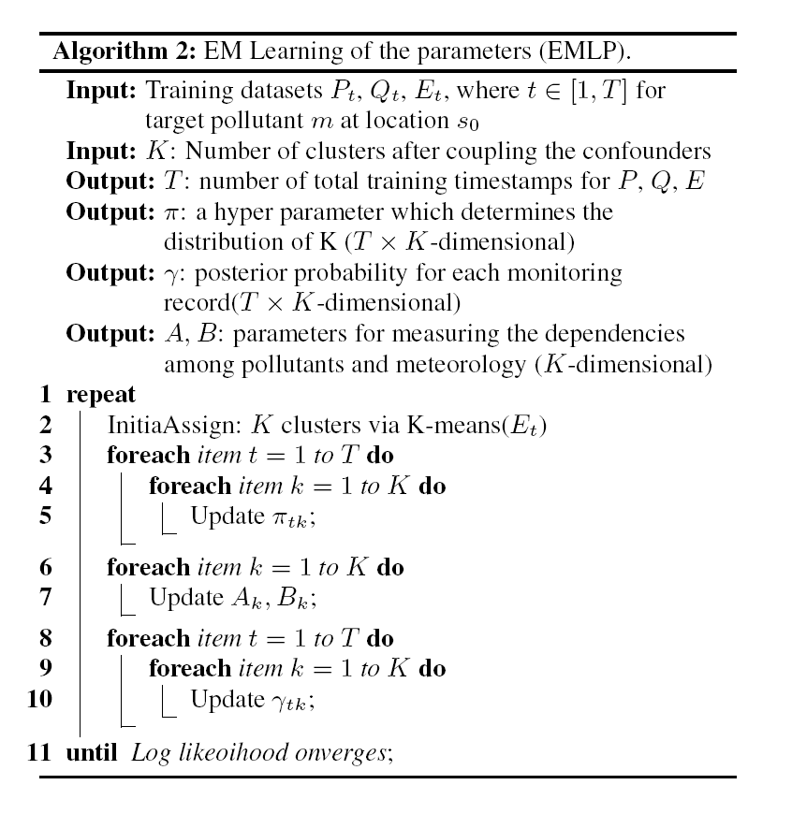
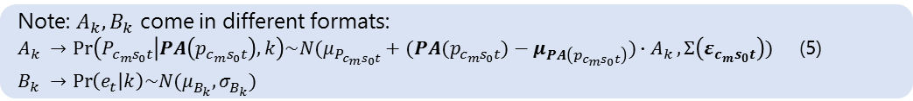
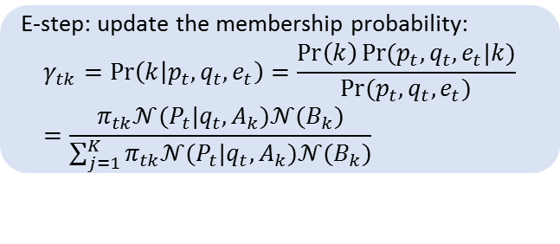
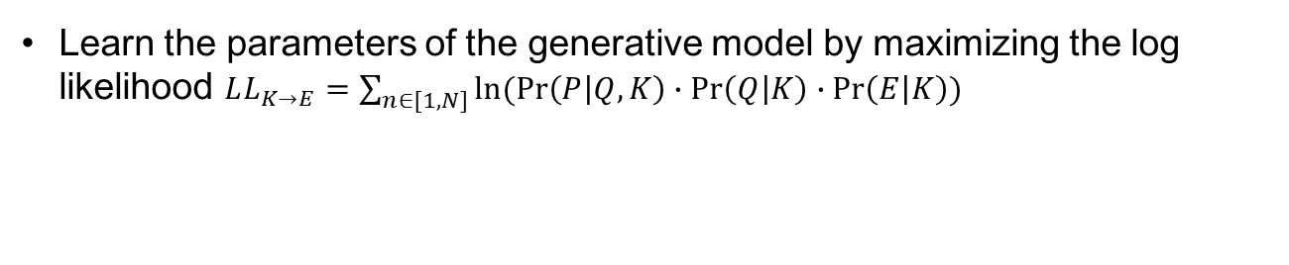
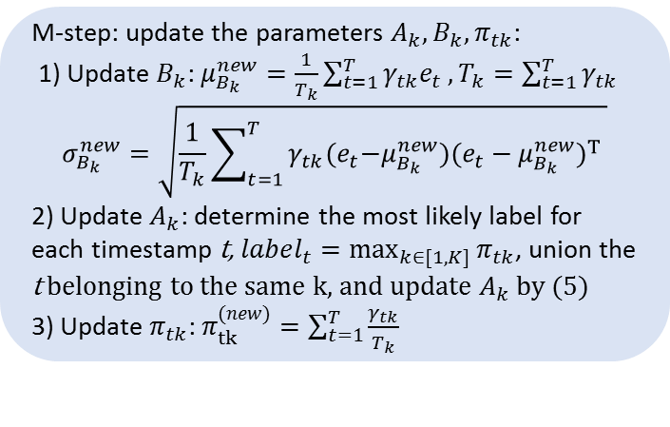
Refine causal structures
Learn the parameters of the generative model by maximizing the log likelihood $LL_{K→E}=\sum_{n∈[1,N]}{ln⁡(Pr\left(P | Q,K\right)∙Pr\left(Q | K\right)∙Pr\left(E | K\right))}$
Expectation-maximization (EM)
E-step: update the membership probability:
$$γ_{tk}=\operatorname{Pr}\left(k | p_{t},q_{t},e_{t}\right)=\frac{\operatorname{Pr}\left(k\right)Pr⁡(p_{t},q_{t},e_{t}|k)}{Pr⁡(p_{t},q_{t},e_{t})}=\frac{π_{tk}𝒩(P_{t}|q_{t},A_{k})𝒩(B_{k})}{\sum_{j=1}^{K}{π_{tk}𝒩(P_{t}|q_{t},A_{k})𝒩(B_{k})}}$$
M-step: update the parameters $A_{k},B_{k},π_{tk}$:
1) Update $B_{k}$: $μ_{B_{k}}^{new}=\frac{1}{T_{k}}\sum_{t=1}^{T}{γ_{tk}e_{t}}, T_{k}=\sum_{t=1}^{T}{γ_{tk}}$
$$σ_{B_{k}}^{new}=\sqrt{\frac{1}{T_{k}}\sum_{t=1}^{T}{γ_{tk}{(e}_{t}−μ_{B_{k}}^{new}){(e_{t}−μ_{B_{k}}^{new})}^{T} }}$$
2) Update $A_{k}$: determine the most likely label for each timestamp t, $label_{t}=\max_{k∈[1,K]}{π_{tk}}$, union the t belonging to the same k, and update $A_{k}$ by (5)
3) Update $π_{tk}$: $π_{tk}^{(new)}=\sum_{t=1}^{T}{\frac{γ_{tk}}{T_{k}}}$
Note: $A_{k},B_{k}$ come in different formats:
$A_{k} →\operatorname{Pr}\left(P_{c_{m}s_{0}t} | PA\left(p_{c_{m}s_{0}t}\right),k\right)\sim N(μ_{P_{c_{m}s_{0}t}}+(PA(p_{c_{m}s_{0}t})−μ_{PA\left(p_{c_{m}s_{0}t}\right)})∙A_{k},Σ\left(ε_{{c_{m}s}_{0}t}\right))$ (5)
$$B_{k} →\operatorname{Pr}\left(e_{t} | k\right)\sim N(μ_{B_{k}}^{},σ_{B_{k}}^{})$$

Slide 28
An example of training process
Input: selected N=3 candidate cities
Output: Updated causal structures for optimal K clusters
Initialization: k-means of environmental factors for K clusters
Iteration: 10

Slide 29
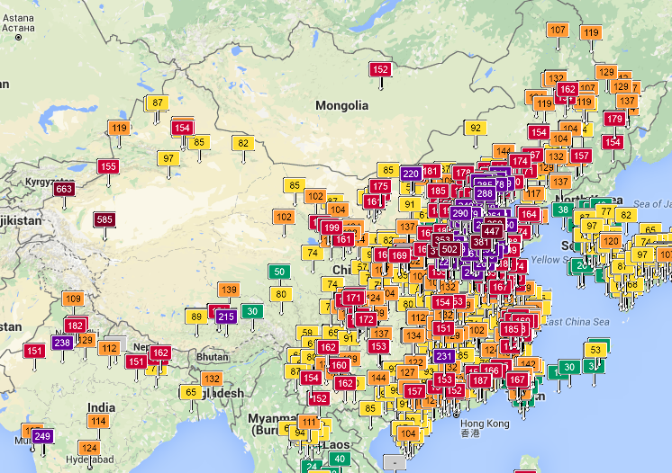
Experiments
Datasets:
Three regions: we use 11 urban dynamics from 128 cities, 982 air quality monitoring stations, 812 meteorology stations
North China (NC), 35N-43N, 110E-123E
Yangtze River Delta (YRD), 28N-35N, 115E-123E
Pearl River Delta (PRD), 22N-25N, 110E-116E
Time span: 06/01/2013 - 12/31/2016
Four seasons: we divide data into four seasons for training. For testing, we use the last 15 days in each season in year 2014, 2015, 2016 respectively. So we have 30 days of testing data for each season.
Source: http://aqicn.org/

Slide 30
Verification
Verification of causality is a difficult task
Traditional models -> intervention in a causal system (control the medicine on different groups of patients)
Air quality -> impossible to conduct experimental intervention. How?
We verify the causality with real-world data from four perspectives:
1. Inference accuracy
2. Time efficiency and scalability
Baseline Bayesian structure learning methods: MWST, MCMC, K2+PS
City level -> station level
3. Synthetic data
4. Visualization & interpretability
Compare the learnt causal structure with structures learnt by other
Bayesian structure learning methods
Case study for Beijing PM2.5

Slide 31
Accuracy
Table 1. PM2.5 Accuracy vs. Parameters (Time lag = 3)
Beijing, Shanghai, and Shenzhen

Slide 32
Time efficiency with baselines (city, 6 pollutants in four seasons)
Time (s) | m = 1 | m = 2 | m = 3 | m = 4 | m = 5 | m = 6
Section 4.1 - 4.2 | 2.74 | 3.49 | 3.98 | 3.74 | 3.94 | 3.71
Section 4.3 | 29.88 | 43.28 | 55.15 | 39.07 | 45.44 | 43.13
Section 5.1 (p + g) | 73.43 | 111.33 | 151.63 | 94.56 | 136.64 | 128.47
Section 5.1 (g) | 1125.51 | 1076.97 | 1068.13 | 1074.94 | 1057.67 | 1082.85
Section 5.2 | -- | -- | -- | -- | -- | --
Section 5.3 | 38421.53 | 42094.47 | 39137.81 | 44162.31 | 49192.68 | 44601.73
pg-Causality | 38527.58 | 42252.57 | 39348.57 | 44299.68 | 49378.7 | 44777.04
pg-Causality-n | 39547.04 | 43171.44 | 40205.94 | 45237.25 | 50250.35 | 45684.58
MWST | 6357.9 | 6529.88 | 6605.31 | 7033.58 | 7216.45 | 7374.13
CGBN | 72785.54 | 79165.28 | 80356.3 | 75578.74 | 79623.57 | 78191.32
MCMC | 524731.63 | 562835.19 | -- | -- | -- | --
K2 + PS | 286592.52 | 324851.47 | -- | -- | -- | --
--: don’t take up computation time
X: not computable
Notes:
Pollutant type m = 1~6

Slide 33
Scalability

Slide 34
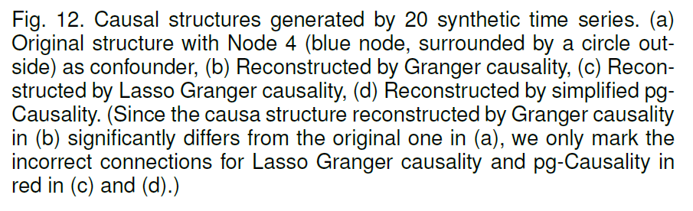
Verification with Synthetic Data
Since the verification of causality via prediction task may not fully reflect the cause-and-effect relationships learned by the model,
We further conduct experiments with synthetic data to judge whether the causality identification is correct or not.

Slide 35
Visualization
Compare the learnt causal structure with structures learnt by other Bayesian structure learning methods (Causal pathway for Beijing PM2.5 in Spring, Figure a, d-h)
Notes:
More clearer pathways using pg-Causality, than baselines.

Slide 36
Case study: Beijing PM2.5
Impossible to conduct human intervention to verify the causality of air pollutants. We use other facts for verification (Figure b & c):
Location of major plants in the center of North China
APEC period (Nov 1~14, 2014, Chinese government shuttered factories factories in North China, and licensed plate traffic bans in Beijing.)
Regarding to PM2.5 in Beijing
(a) Concatenate most likely causal pathways
(b) Causal pathways during APEC
(c) Major plants locations

Slide 37
Insights from causal pathway learning
Regarding to PM2.5 in Beijing
(a) Concatenate most likely causal pathways (step by step)
What most likely influences the 1-hop neighbors?
1-hop most influential neighborhood pollutants

Slide 38
Insights from causal pathway learning
Regarding to PM2.5 in Beijing
(a) Concatenate most likely causal pathways (step by step)
What most likely influences the 2-hop neighbors?
2-hop most influential neighborhood pollutants

Slide 39
Insights from causal pathway learning
Regarding to PM2.5 in Beijing
(a) Concatenate most likely causal pathways (step by step)
3-hop most influential neighborhood pollutants

Slide 40
Insights from causal pathway learning
Regarding to PM2.5 in Beijing
How to generate causal pathways for Beijing PM2.5?
Concatenate most likely causal pathways, Jan - Mar

Slide 41
Optimal number of neighbors and clusters for each city, based on maximized causal inference accuracy.

Slide 42
Insights from causal pathway learning
Regarding to PM2.5 in Beijing
(a) Concatenate most likely causal pathways
(b) Causal pathways during APEC
(c) Major plants locations
Most likely from
south and north-east.
More likely from neighbor.

Slide 43
Insights from causal pathway learning
Regarding to PM2.5 in Beijing
(a) Concatenate most likely causal pathways
(b) Causal pathways during APEC
(c) Major plants locations
Most likely from
south and north-east.
Pathways correspond to the locations of plants

Slide 44
Conclusion
We identified the causal pathways of air pollutants using large-scale air quality data and meteorological data.
A novel causal pathway learning approach named p-Causality that tightly combines pattern mining and Bayesian learning.
We have performed extensive experiments on three real-word data sets.
It outperforms baseline methods in terms of both efficiency and inference accuracy. Moreover,
highly interpretable and meaningful.
For future work, we plan to apply the pattern-aided statistical modeling framework of p-Causality for other tasks such as traffic congestion analysis.

